Slide 1
Tehlikeli Proseslerde Emniyet Retrofit Uygulamaları ve Dijital Çözümler
Sergej Arent / Uygulamalar Direktörü
HIMA Paul Hildebrandt GmbH
12-13 Eylül 2023

Slide 2
Your speaker
Sergej Arent
Uygulamalar Direktörü / Director Applications, HIMA Group
25 years of experience in the process industry
In HIMA since 2007
The HIMA Group is the world’s leading independent provider of safety-related automation solutions for the process and railway industries to protect people, the environment, and assets.
Founded in 1908 and headquartered in Germany, the family-owned company counts about 900 employees and operates from over 50 locations worldwide.

Slide 3
What is a Risk?
Risk
Probability of an event happening
Consequences of the event

Slide 4
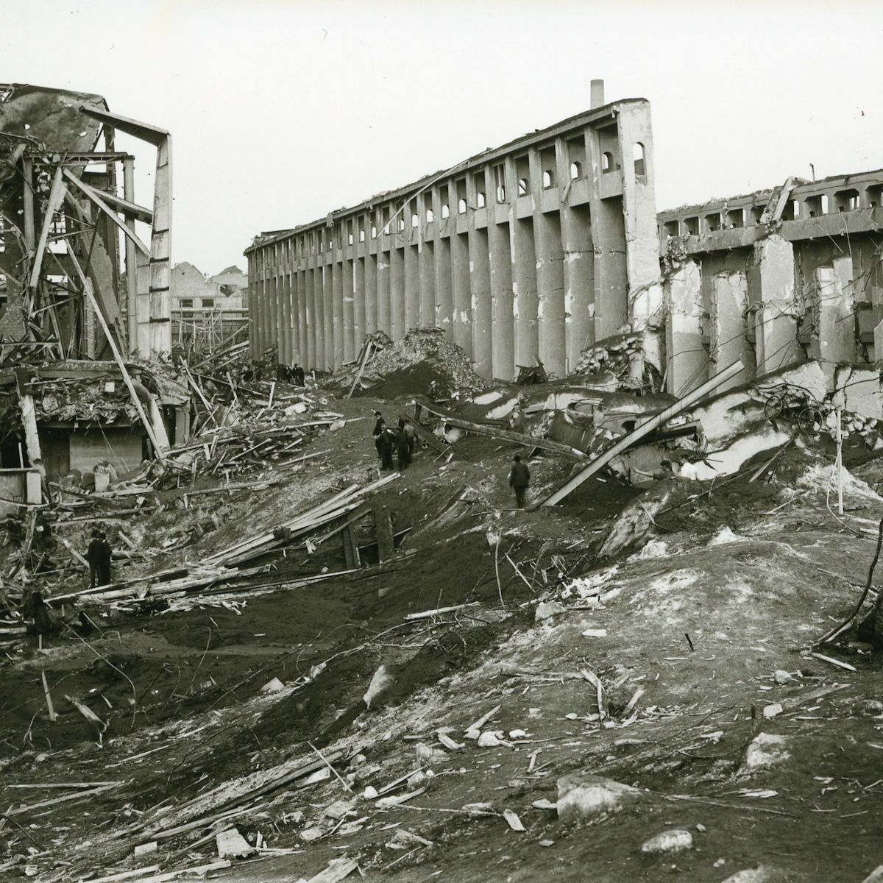
A very low probability does not mean very low risk
BASF Oppau Fertilizer Explosion
Over 500 lives lost
Major destruction of the plant and surrounding communities
“
The procedure
has been carried out safely around 20,000 times before.
On that day, everything was different.
A reminder that we must do everything possible to ensure that such a disaster does not happen again.
Dr. Martin Brudermüller
CEO of BASF
2021 - 100th anniversary of the explosion event
Notes:
On September 21, 1921, the young Oppau plant is hit by a massive explosion. Over 500 lives are mourned; the plant and surrounding communities suffer major destruction. The incident occurs during routine blasts carried out to loosen ammonium sulfate nitrate fertilizer stored in a warehouse. In response to the explosion accident, BASF terminates the production of ammonia sulfate nitrate fertilizer and does not resume it until 1940 applying a modified process.
https://www.basf.com/global/en/who-we-are/history/Oppau1921.html

Slide 5
A very low probability does not mean very low risk
2010 - Deepwater Horizon Disaster
Largest spill in the history
11 crew members died
Estimated total costs for BP: $62 billion
The explosive loss of the Macondo well was caused by a series of identifiable mistakes and could have been prevented.
National Commission on the BP Deepwater Horizon Oil Spill and Offshore Drilling
January 2011
“
Notes:
Let’s examine this in more detail using the Deepwater Horizon disaster in 2010 as an example (background image).
The oil rig explosion cost the operator BP a total of 62 billion US dollars, of which 20 billion dollars were penalties.
As a result of our investigation, we conclude: • The explosive loss of the Macondo well could have been prevented. • The immediate causes of the Macondo well blowout can be traced to a series of identifiable mistakes made by BP, Halliburton, and Transocean that reveal such systematic failures in risk management that they place in doubt the safety culture of the entire industry. • Deepwater energy exploration and production, particularly at the frontiers of experience, involve risks for which neither industry nor government has been adequately prepared, but for which they can and must be prepared in the future. • To assure human safety and environmental protection, regulatory oversight of leasing, energy exploration, and production require reforms even beyond those significant reforms already initiated since the Deepwater Horizon disaster. Fundamental reform will be needed in both the structure of those in charge of regulatory oversight and their internal decisionmaking process to ensure their political autonomy, technical expertise, and their full consideration of environmental protection concerns. • Because regulatory oversight alone will not be sufficient to ensure adequate safety, the oil and gas industry will need to take its own, unilateral steps to increase dramatically safety throughout the industry, including self-policing mechanisms that supplement governmental enforcement. • The technology, laws and regulations, and practices for containing, responding to, and cleaning up spills lag behind the real risks associated with deepwater drilling into large, high-pressure reservoirs of oil and gas located far offshore and thousands of feet below the ocean’s surface. Government must close the existing gap and industry must support rather than resist that effort. • Scientific understanding of environmental conditions in sensitive environments in deep Gulf waters, along the region’s coastal habitats, and in areas proposed for more drilling, such as the Arctic, is inadequate. The same is true of the human and natural impacts of oil spills.
govinfo.gov/content/pkg/GPO-OILCOMMISSION/pdf/GPO-OILCOMMISSION.pdf

Slide 6
Process Safety in the Industry
Simplified Storage Tank Example
In
Control Room
Failsafe
Safety
Mechanical Protection
Alarm
Panel
Process Control
Disaster
Prevention
Out
Damage Mitigation
Emergency Exit
Assets
Environment
People

Slide 7
Process Safety in the Industry
61511
Risk Reduction → Safety
Risk Reduction
Disaster Prevention
Layers of protection
Protection Layer: any independent mechanism that reduces risk by control, prevention or mitigation.
Damage Mitigation
Mechanical Protection
Safety Instrumented Systems
In existing plants:
Check specifically for this layer.
Modernization will ensure
Safety Increase
Compliance with laws and regulations
Costs Savings over the life cycle
Process Monitoring
Operation & Process Automation
Notes:
An intuitive way of representing the risk reduction capability of a Safety Instrumented System is to use the concept of Protection layer as described in IEC 61511-1. [IEC 61511-1] 3.2 Terms and definitions – 3.2.57 Protection Layer: any independent mechanism that reduces risk by control, prevention or mitigation.

Slide 8
Process Safety in the Industry
Risk Reduction → Safety
Risk Reduction
Disaster Prevention
There is no safety without security
Damage Mitigation
Mechanical Protection
Safety Instrumented Systems
Process Monitoring
Operation & Process Automation

Slide 9
Correlation of Safety & Security
Process
Functional
Safety
Security
Weekly updates
Focus on weak points
Benefit from the experience from other users, and communities
Updates in years
Focus in case of malfunction
Use of (own) operating experience

Slide 10
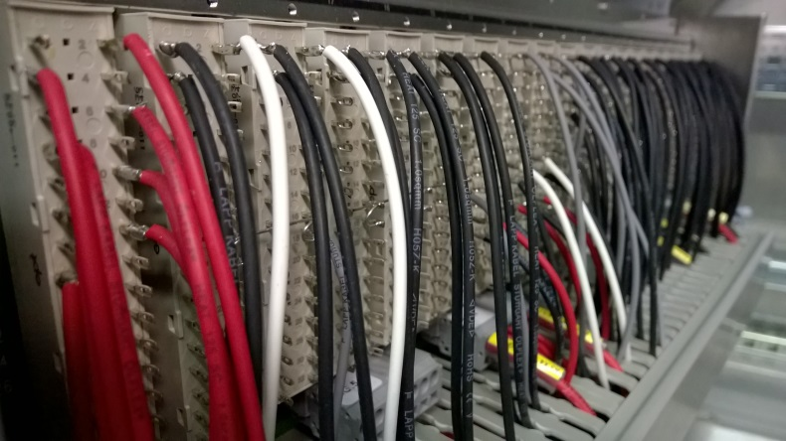
100% Security?
Hardwired → 100% Secure
Used for specific applications such as the High Integrity Pressure Protection Sydtems

Slide 11
100% Security?
Reality
Automation System Networks
Enterprise Resource Planning
ERP
Office
Remote Access
SCADA
Engineering
Update Server
Security Controller
Asset
Management
Machine Interface
Engineering
Process Control
open
Process
Safety
secure
4…20mA HART
Fieldbus
A
A
A
Intelligent Sensors
A
A
A
Fieldbus

Slide 12
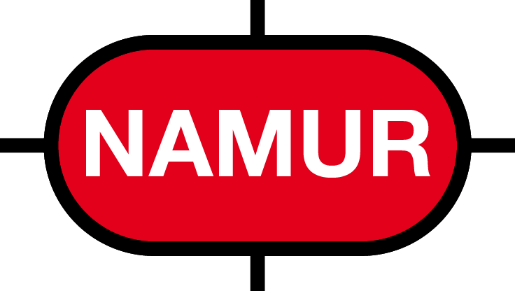
Expert Commissions: Central Statements
62443
84.00.09
NA 163
Security Requirements:
Reference should be made to the process hazard analysis (PHA).
Integrated systems: More effort.
CRS requires drawings and characteristics of zones and lines
For each zone and conduit, the logical boundaries, logical access points, data flows, and connectivity must be identified and documented.
Separate Safety Instrumented Systems:
Logical or physical separation of non-safety-related equipment
Safety-relevant zones require a higher level of safety protection
Security Requirements:
Defense-In-Depth reduces risks
The management of independent systems is less complex
If a high external risk is identified, an air-gapped or interfaced solution should be provided
Integrated systems: More effort.
Integrated systems "(...) need to be much more emphasized to reduce potential outside intrusion"
Separate Safety Instrumented Systems :
Separation or isolation of safety zones
Diversity in technology recommended
Security Requirements:
The safety risk assessment should be based on the results of IEC 61508 / IEC 61511 in terms of sufficient separation and independence.
In the case of the use of common components, the safety risk assessment should conclude that there is no unacceptable risk.
Separate Safety Instrumented Systems :
SIS should be independent and free from interference by Process Control Systems

Slide 13
Operator requirements: Central Statements
Operator requirements for Functional Safety
HIMA approach to the digitization of Functional Safety:
1. Conformity License to Operate
1. HIMA goes Digital
2. Flexibility
Freedom of Choice
2. Safety & Security
Sustainable Lifecycle Risk Management
#safety goes digital
Independent Open Safety Platform
3. Sustainability
3. Digital Safety Lifecycle
4. Mastery Skills Shortage
4. HIMA Digital Solutions
5. Investment Protection Economic Efficiency

Slide 14
Teşekkürler
#safetygoesdigital

Slide 15
FUAR İÇİ 41040 İZMİT/KOCAELİ
TEL: +90 262 315 80 00
FAX: +90 262 321 90 70
WEB: www.kosano.org.tr
E-MAIL: kso@kosano.org.tr

